Slide 1
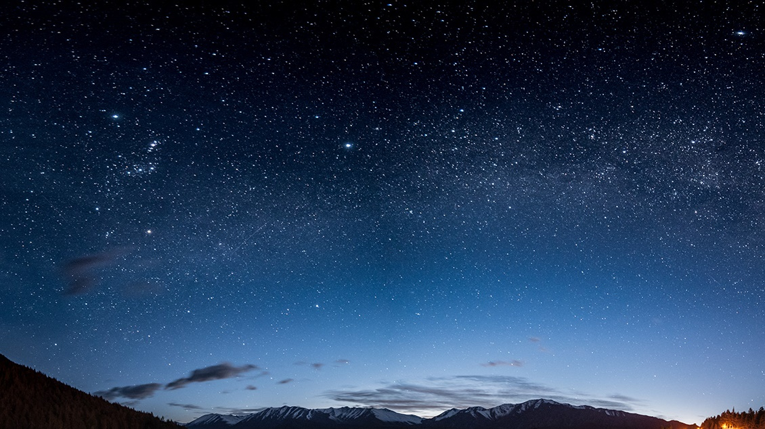
Motivated by Hope
Daniel 8-9, Ezra 7
The Great Controversy Ch. 18-21
Lesson 7, 2nd Quarter 2024

Slide 2
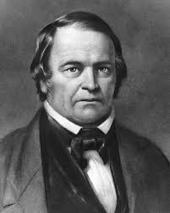
An American Reformer
The Great Controversy, p. 317
“An upright, honest-hearted farmer, who had been led to doubt the divine authority of the Scriptures, yet who sincerely desired to know the truth, was the man specially chosen of God to lead out in the proclamation of Christ's second coming.”

Slide 3
The Great Controversy, p. 318
Deism: The belief that God created the world but does not influence events. Deists believe that reason is the only source of divine knowledge. Thus they reject the scriptures.
“His mother was a woman of sterling piety, and in childhood, he had been subject to religious impressions. In early manhood, however, he was thrown into the society of deists, whose influence was the stronger from the fact that they were mostly good citizens and men of humane and benevolent disposition.”

Slide 4
Memoirs of William Miller (Bliss, Sylvester 1853).
Miller joined the army and fought in the War of 1812. He saw his first action at the Battle of Plattsburgh, where vastly outnumbered American forces overcame the British. He later wrote, "It seemed to me that the Supreme Being must have watched over the interests of this country in an especial manner, and delivered us from the hands of our enemies... So surprising a result, against such odds, did seem to me like the work of a mightier power than man."

Slide 5
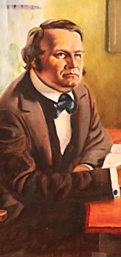
The Great Controversy, p. 319
“Suddenly,” he says, “the character of a Saviour was vividly impressed upon my mind. It seemed that there might be a being so good and compassionate as to himself atone for our transgressions, and thereby save us from suffering the penalty of sin. I immediately felt how lovely such a being must be…”

Slide 6
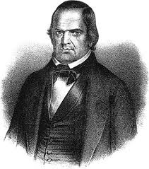
The Great Controversy, p. 319
“and imagined that I could cast myself into the arms of, and trust in the mercy of, such a one. But the question arose, How can it be proved that such a being does exist? Aside from the Bible, I found that I could get no evidence of the existence of such a Saviour, or even of a future state....

Slide 7
Memoirs of William Miller (Bliss, Sylvester 1853).
“I was constrained to admit that the Scriptures must be a revelation from God. They became my delight; and in Jesus I found a friend….the Scriptures, which before were dark and contradictory, now became the lamp to my feet and light to my path…The Bible now became my chief study, and I can truly say, I searched it with great delight…I wondered why I had not seen its beauty and glory before, and marveled that I could have ever rejected it. I found everything revealed that my heart could desire, and a remedy for every disease of the soul. I lost all taste for other reading, and applied my heart to get wisdom from God.”

Slide 8
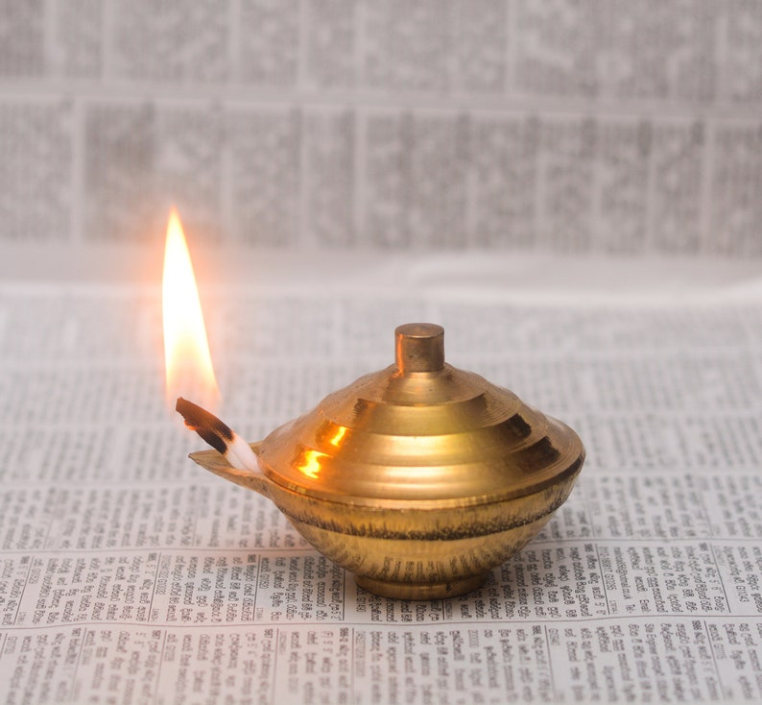
The Great Controversy, p. 320
“Endeavoring to lay aside all preconceived opinions, and dispensing with commentaries, he compared scripture with scripture by the aid of the marginal references and the concordance. He pursued his study in a regular and methodical manner; beginning with Genesis, and reading verse by verse…When he found anything obscure, it was his custom to compare it with every other text which seemed to have any reference to the matter under consideration.”

Slide 9
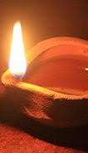
The Great Controversy, p. 320
“Every word was permitted to have its proper bearing upon the subject of the text, and if his view of it harmonized with every collateral passage, it ceased to be a difficulty. Thus whenever he met with a passage hard to be understood he found an explanation in some other portion of the Scriptures. As he studied with earnest prayer for divine enlightenment, that which had before appeared dark to his understanding was made clear.”

Slide 10
William Miller’s Bible Study Process:
All portions of scripture are true revelations from God
  (Methodical manner, beginning in Genesis, all the way to Revelation.)
The Bible is internally consistent
  (Assumption that apparent inconsistencies can be resolved through study.)
Understanding comes through context and comparison
  (ALL passages with any relation to questioned passage are considered.)
The Holy Spirit teaches God’s Word
  (Study with prayer for divine enlightenment.)

Slide 11
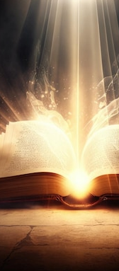
The Great Controversy, p. 320
“With intense interest he studied the books of Daniel and the Revelation, employing the same principles of interpretation as in the other scriptures, and found, to his great joy, that the prophetic symbols could be understood….“I was thus satisfied,” he says, “that the Bible is a system of revealed truths, so clearly and simply given that the wayfaring man, though a fool, need not err therein.”

Slide 12
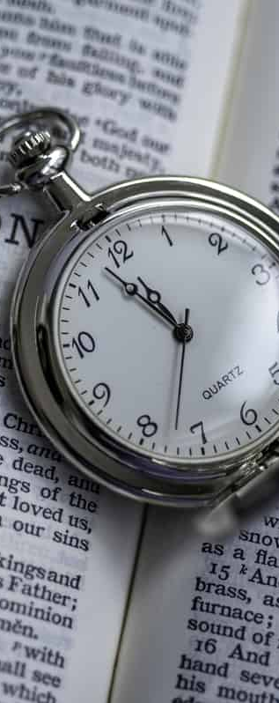
The Great Controversy, p. 324
“The prophecy which seemed most clearly to reveal the time of the second advent was that of Daniel 8:14…Miller accepted the generally received view that in the Christian age the earth is the sanctuary, and he therefore understood that the cleansing of the sanctuary foretold in Daniel 8:14 represented the purification of the earth by fire at the second coming of Christ. If, then, the correct starting point could be found for the 2300 days, he concluded that the time of the second advent could be readily ascertained.”

Slide 13
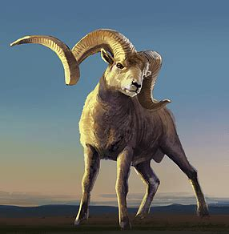
The Investigative Judgment: Daniel 8:3-27
³ Then I lifted up mine eyes, and saw, and, behold, there stood before the river a ram which had two horns: and the two horns were high; but one was higher than the other, and the higher came up last.

Slide 14
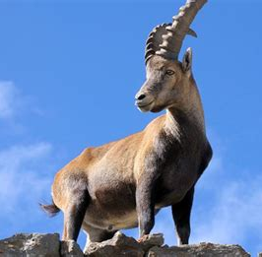
The Investigative Judgment: Daniel 8:4-27
⁴ I saw the ram pushing westward, and northward, and southward; so that no beasts might stand before him, neither was there any that could deliver out of his hand; but he did according to his will, and became great.

Slide 15
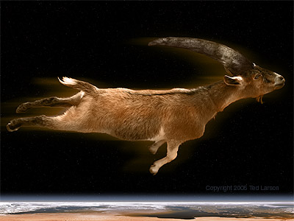
The Investigative Judgment: Daniel 8:5-27
⁵ And as I was considering, behold, an he goat came from the west on the face of the whole earth, and touched not the ground: and the goat had a notable horn between his eyes.

Slide 16
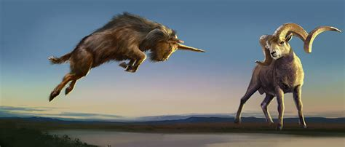
The Investigative Judgment: Daniel 8:6-27
⁶ And he came to the ram that had two horns, which I had seen standing before the river, and ran unto him in the fury of his power.

Slide 17
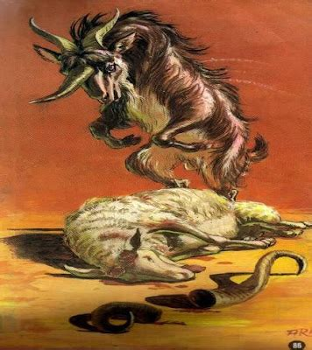
The Investigative Judgment: Daniel 8:7-27
⁷ And I saw him come close unto the ram, and he was moved with choler against him, and smote the ram, and brake his two horns: and there was no power in the ram to stand before him, but he cast him down to the ground, and stamped upon him: and there was none that could deliver the ram out of his hand.

Slide 18
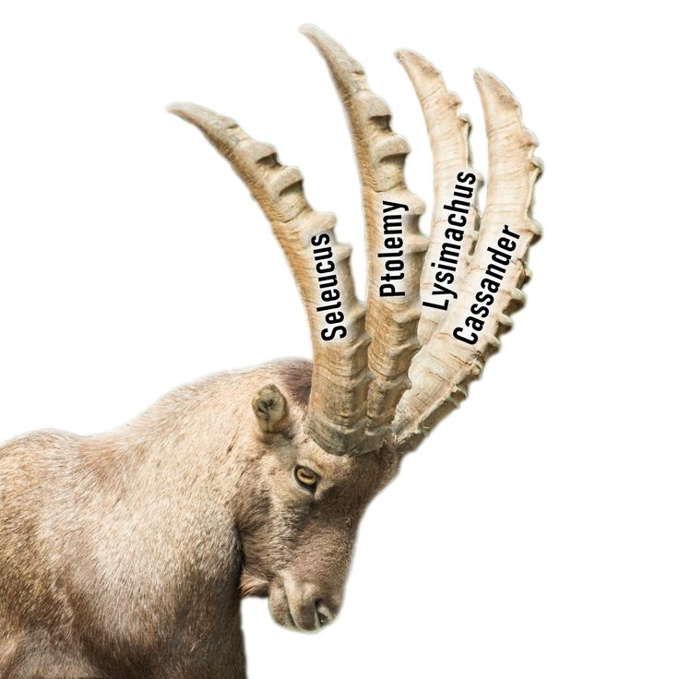
The Investigative Judgment: Daniel 8:8-27
⁸ Therefore the he goat waxed very great: and when he was strong, the great horn was broken; and for it came up four notable ones toward the four winds of heaven.

Slide 19
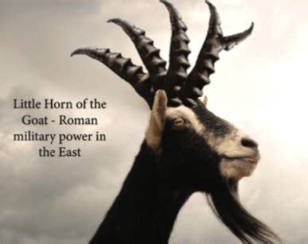
The Investigative Judgment: Daniel 8:9-27
⁹ And out of one of them came forth a little horn, which waxed exceeding great, toward the south, and toward the east, and toward the pleasant land.

Slide 20
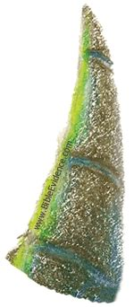
The Investigative Judgment: Daniel 8:10-27
¹⁰ And it waxed great, even to the host of heaven; and it cast down some of the host and of the stars to the ground, and stamped upon them.

Slide 21
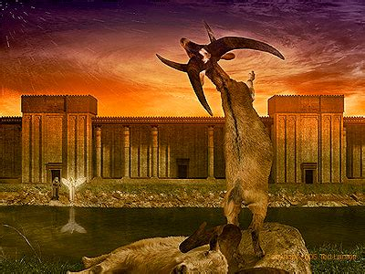
The Investigative Judgment: Daniel 8:11-27
¹¹ Yea, he magnified himself even to the prince of the host, and by him the daily sacrifice was taken away, and the place of the sanctuary was cast down.

Slide 22
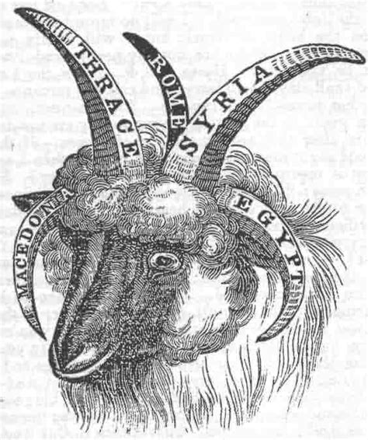
The Investigative Judgment: Daniel 8:12-27
¹² And an host was given him against the daily sacrifice by reason of transgression, and it cast down the truth to the ground; and it practised, and prospered.

Slide 23
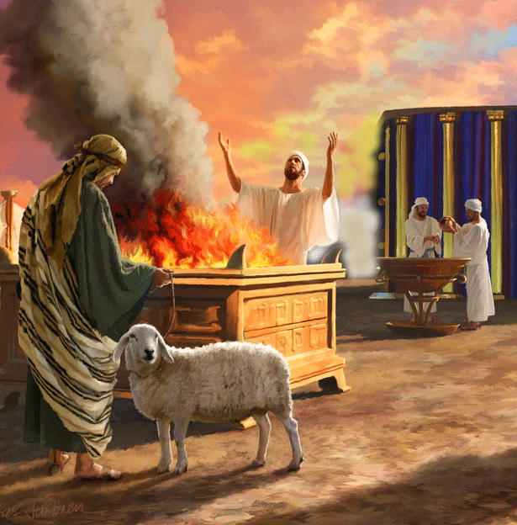
The Investigative Judgment: Daniel 8:13-27
¹³ Then I heard one saint speaking, and another saint said unto that certain saint which spake, How long shall be the vision concerning the daily sacrifice, and the transgression of desolation, to give both the sanctuary and the host to be trodden under foot?

Slide 24
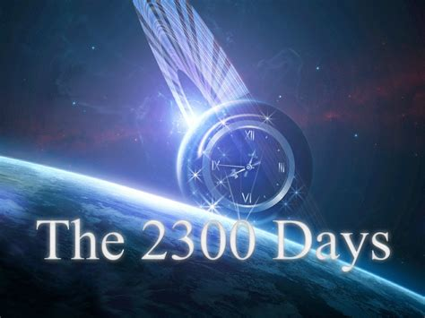
The Investigative Judgment: Daniel 8:14-27
¹⁴ And he said unto me, Unto two thousand and three hundred days; then shall the sanctuary be cleansed.

Slide 25
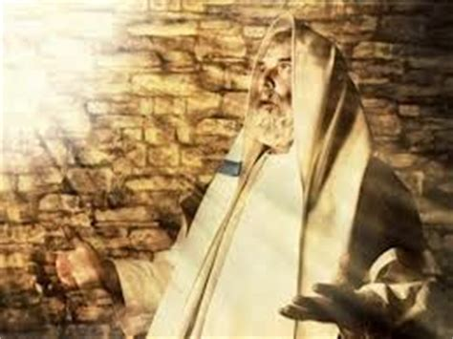
The Investigative Judgment: Daniel 8:15-27
¹⁵ And it came to pass, when I, even I Daniel, had seen the vision, and sought for the meaning, then, behold, there stood before me as the appearance of a man.

Slide 26
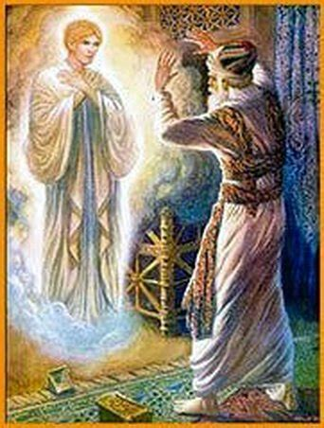
The Investigative Judgment: Daniel 8:16-27
¹⁶ And I heard a man's voice between the banks of Ulai, which called, and said, Gabriel, make this man to understand the vision.

Slide 27
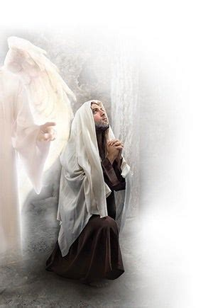
The Investigative Judgment: Daniel 8:17-27
¹⁷ So he came near where I stood: and when he came, I was afraid, and fell upon my face: but he said unto me, Understand, O son of man: for at the time of the end shall be the vision.

Slide 28
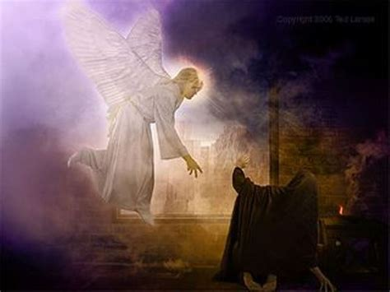
The Investigative Judgment: Daniel 8:18-27
¹⁸ Now as he was speaking with me, I was in a deep sleep on my face toward the ground: but he touched me, and set me upright.

Slide 29
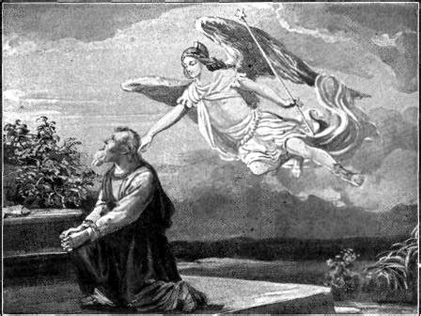
The Investigative Judgment: Daniel 8:19-27
¹⁹ And he said, Behold, I will make thee know what shall be in the last end of the indignation: for at the time appointed the end shall be.

Slide 30
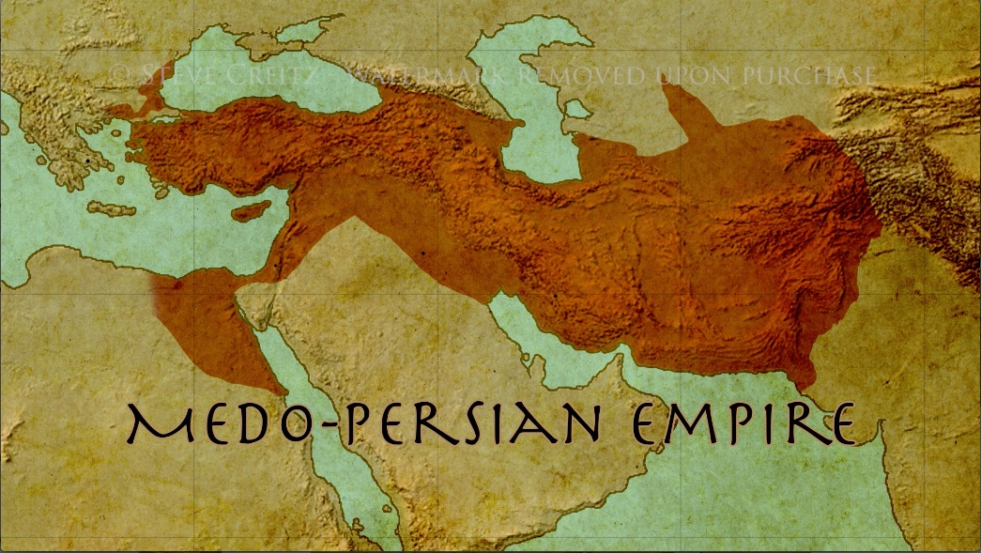
The Investigative Judgment: Daniel 8:20-27
²⁰ The ram which thou sawest having two horns are the kings of Media and Persia.

Slide 31
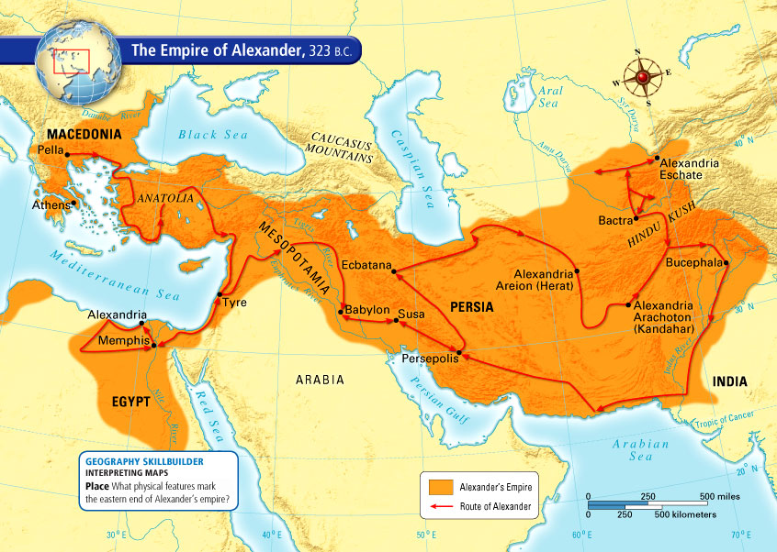
The Investigative Judgment: Daniel 8:21-27
²¹ And the rough goat is the king of Grecia: and the great horn that is between his eyes is the first king.

Slide 32
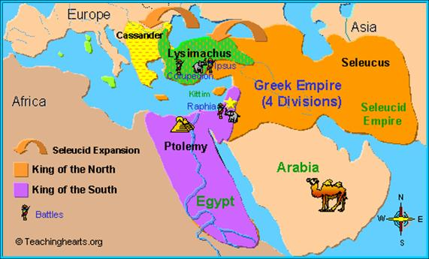
The Investigative Judgment: Daniel 8:22-27
²² Now that being broken, whereas four stood up for it, four kingdoms shall stand up out of the nation, but not in his power.

Slide 33
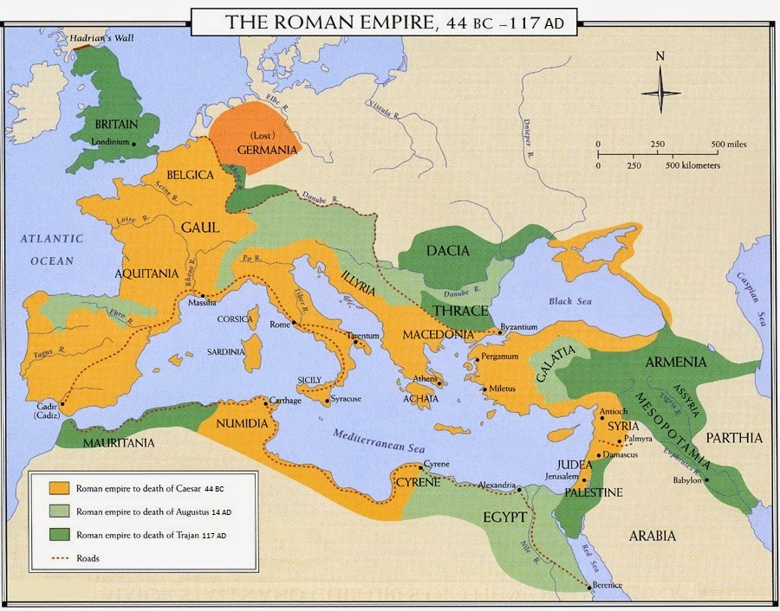
The Investigative Judgment: Daniel 8:23-27
²³ And in the latter time of their kingdom, when the transgressors are come to the full, a king of fierce countenance, and understanding dark sentences, shall stand up.

Slide 34
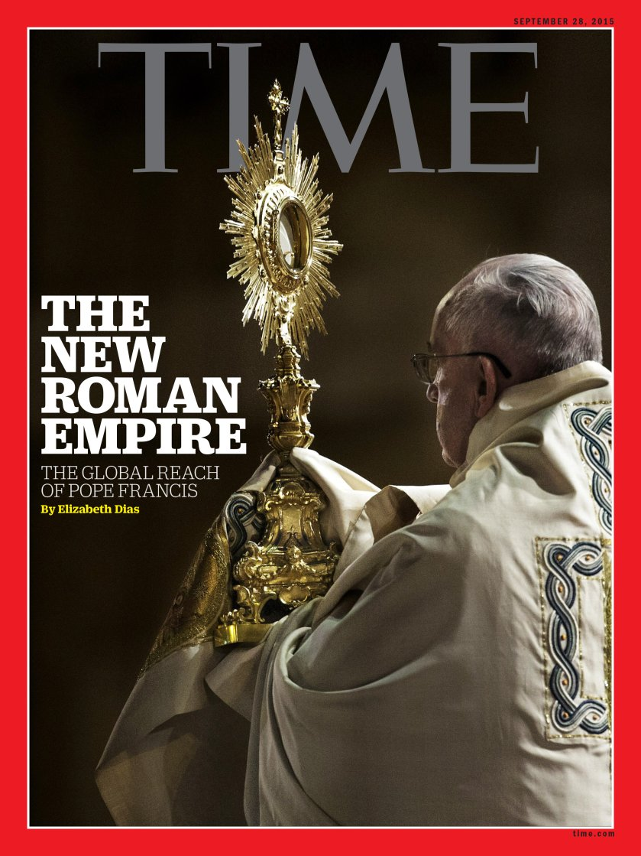
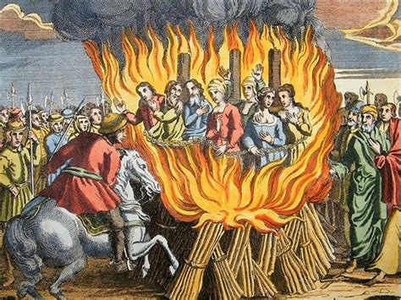
The Investigative Judgment: Daniel 8:24-27
²⁴ And his power shall be mighty, but not by his own power: and he shall destroy wonderfully, and shall prosper, and practise, and shall destroy the mighty and the holy people.

Slide 35
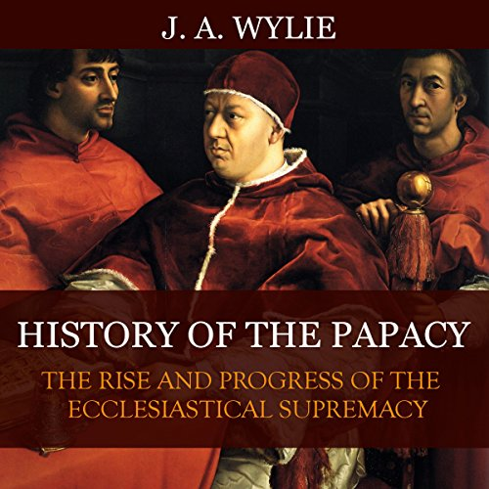
The Investigative Judgment: Daniel 8:25-27
²⁵ And through his policy also he shall cause craft to prosper in his hand; and he shall magnify himself in his heart, and by peace shall destroy many: he shall also stand up against the Prince of princes; but he shall be broken without hand.

Slide 36
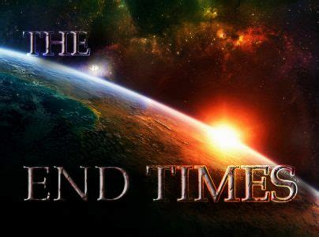
The Investigative Judgment: Daniel 8:26-27
²⁶ And the vision of the evening and the morning which was told is true: wherefore shut thou up the vision; for it shall be for many days.

Slide 37
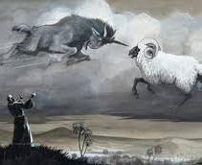
The Investigative Judgment: Daniel 8:27
²⁷ And I Daniel fainted, and was sick certain days; afterward I rose up, and did the king's business; and I was astonished at the vision, but none understood it.

Slide 38
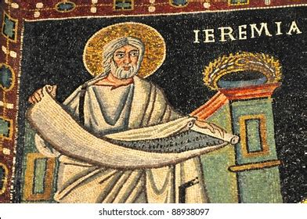
The Investigative Judgment: Daniel 9:2-3
² In the first year of his reign I Daniel understood by books the number of the years, whereof the word of the Lord came to Jeremiah the prophet, that he would accomplish seventy years in the desolations of Jerusalem.

Slide 39
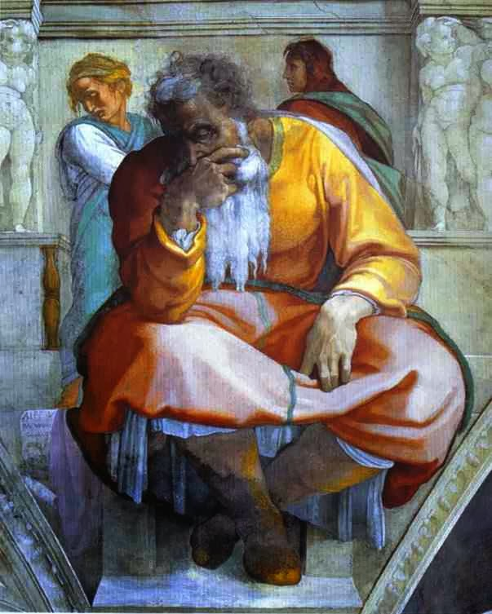
The Investigative Judgment: Daniel 9:3
³ And I set my face unto the Lord God, to seek by prayer and supplications, with fasting, and sackcloth, and ashes:

Slide 40

The Investigative Judgment: SDABC V.4 p.849
Little wonder that Daniel’s attention was focused upon the time prophecy. He was anxious lest the Lord should delay the liberation of His captive people. Although the Lord had promised deliverance to His people at the time appointed, Daniel knew of the conditional nature of many of God’s promises. He may have feared that the impenitence of his people might postpone the fulfillment of the promise. Moreover, the vision of Dan. 8 had predicted further desolation for the sanctuary and the city. His lack of understanding of “the vision of the evening and the morning” (v. 26) must have left him in deep perplexity.

Slide 41
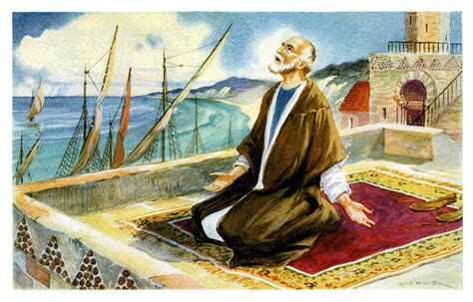
The Investigative Judgment: Daniel 9:20-27
²⁰ And whiles I was speaking, and praying, and confessing my sin and the sin of my people Israel, and presenting my supplication before the Lord my God for the holy mountain of my God;

Slide 42
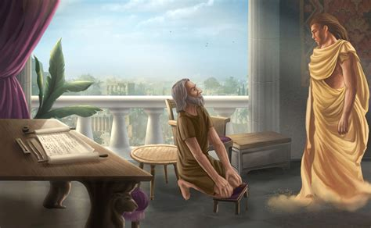
The Investigative Judgment: Daniel 9:21-27
²¹ Yea, whiles I was speaking in prayer, even the man Gabriel, whom I had seen in the vision at the beginning, being caused to fly swiftly, touched me about the time of the evening oblation.

Slide 43
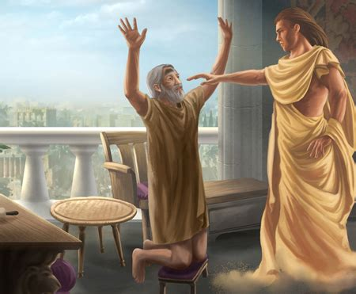
The Investigative Judgment: Daniel 9:22-27
²² And he informed me, and talked with me, and said, O Daniel, I am now come forth to give thee skill and understanding.

Slide 44
The Investigative Judgment: Daniel 9:23-27
²³ At the beginning of thy supplications the commandment came forth, and I am come to shew thee; for thou art greatly beloved: therefore understand the matter, and consider the vision.

Slide 45

The Investigative Judgment: Daniel 9:24-27
²⁴ Seventy weeks are determined upon thy people and upon thy holy city, to finish the transgression, and to make an end of sins, and to make reconciliation for iniquity, and to bring in everlasting righteousness, and to seal up the vision and prophecy, and to anoint the most Holy.

Slide 46
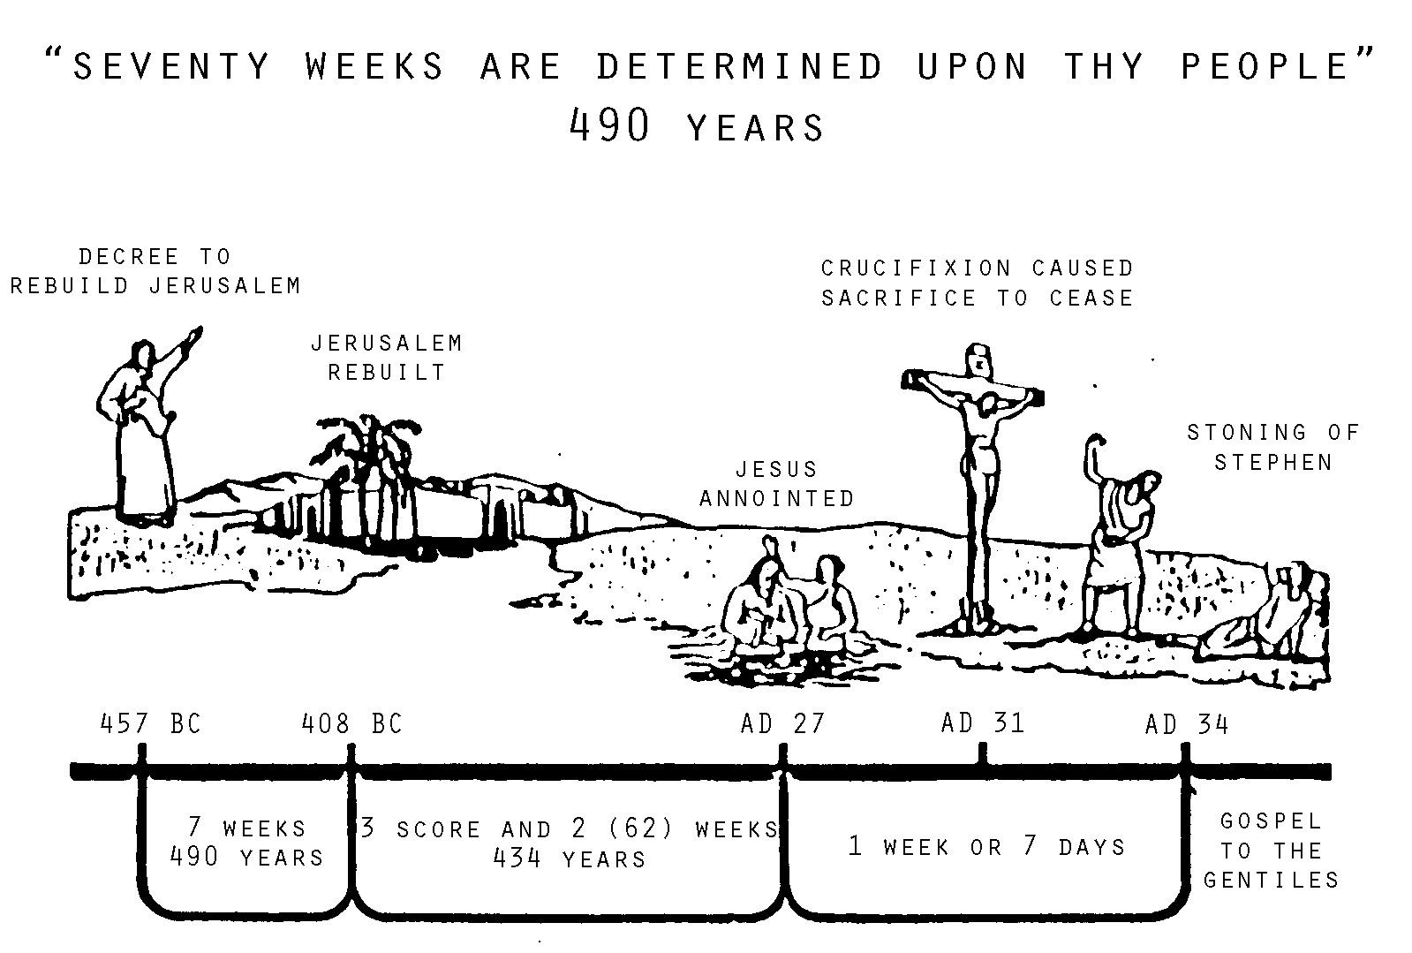

The Investigative Judgment: Daniel 9:25-27
²⁵ Know therefore and understand, that from the going forth of the commandment to restore and to build Jerusalem unto the Messiah the Prince shall be seven weeks, and threescore and two weeks: the street shall be built again, and the wall, even in troublous times.

Slide 47
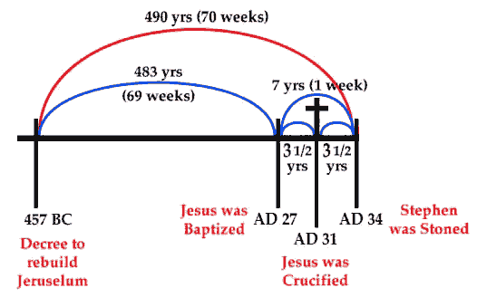
The Investigative Judgment: Daniel 9:26-27
²⁶ And after threescore and two weeks shall Messiah be cut off, but not for himself: and the people of the prince that shall come shall destroy the city and the sanctuary; and the end thereof shall be with a flood, and unto the end of the war desolations are determined.

Slide 48
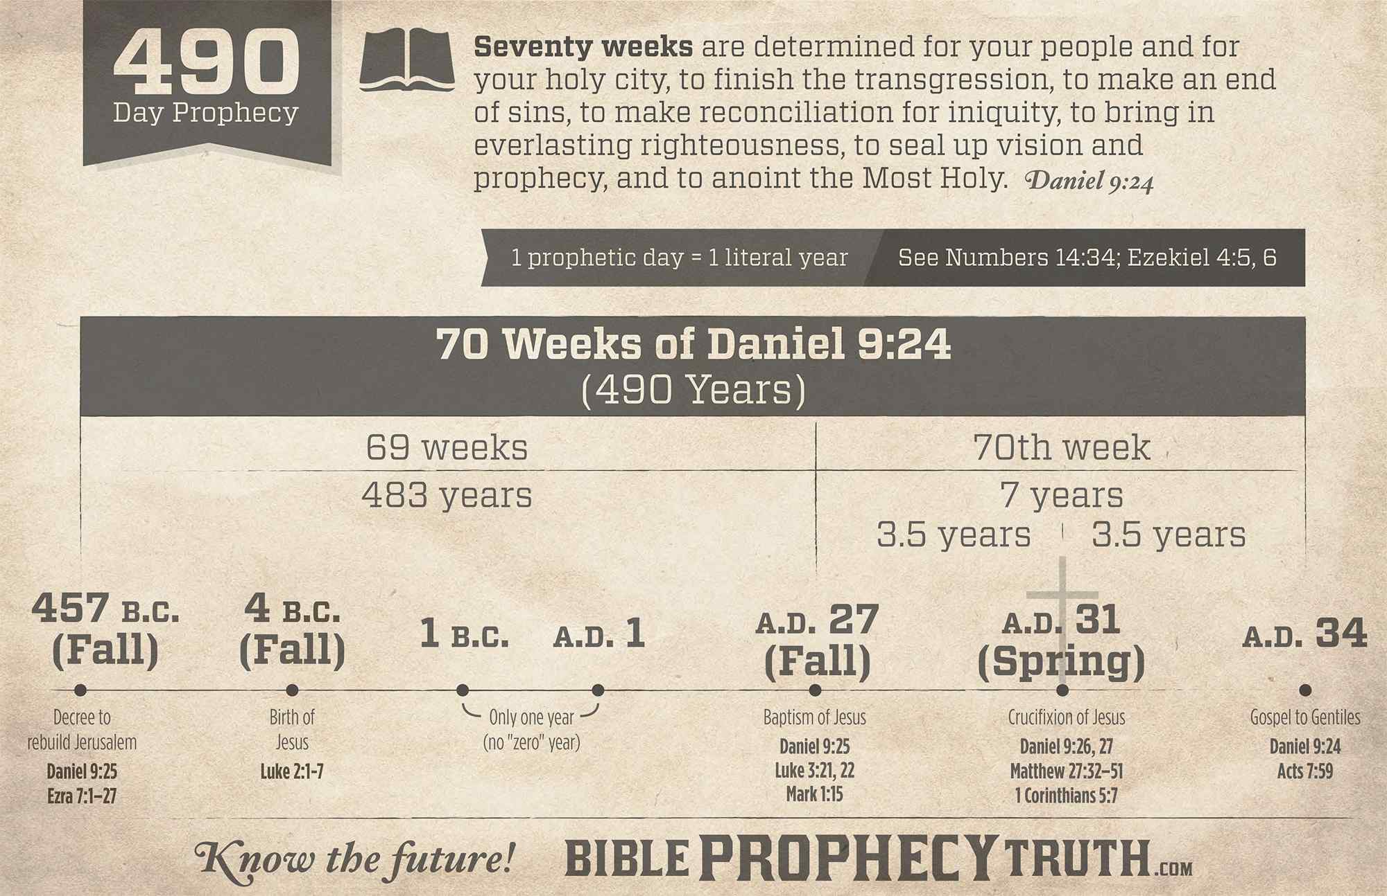
The Investigative Judgment: Daniel 9:27
²⁷ And he shall confirm the covenant with many for one week: and in the midst of the week he shall cause the sacrifice and the oblation to cease, and for the overspreading of abominations he shall make it desolate, even until the consummation, and that determined shall be poured upon the desolate.

Slide 49
Now, Daniel could work out the 2300-day prophecy as a 2300-year prophecy. The year-for-a-day principle is established for the Jewish people prior to this time (Gen. 29:27; Num. 14:34; Eze. 4:5-6). But he doesn’t have a starting place.
This is the same issue that William Miller is facing in the distant future!
How Did We Get to 1844 Anyway?

Slide 50
The 2300 day prophecy is given in sequence with a discussion about Medo-Persia, Greece, and (what we eventually recognize as) Rome. But where does it start? Daniel doesn’t have a beginning place from which to calculate. He’s praying about these issues in Daniel 9.
How Did We Get to 1844 Anyway?

Slide 51
Daniel 9 shows Gabriel providing an answer to Daniel’s prayers regarding his people. They’re going to return to Jerusalem on schedule, but they have 70 “weeks” or 490 years from that point to become the true people of God. (Dan. 9:24-27).
How Did We Get to 1844 Anyway?

Slide 52
It’s “from the going forth of the commandment to restore and to build Jerusalem” (Dan. 9:25). It’s a starting place! The starting place for the 70 week prophecy also provides us with a starting place for the 2300 day prophecy.
How Did We Get to 1844 Anyway?

Slide 53
EZRA 7:12-13
¹² Artaxerxes, king of kings, unto Ezra the priest, a scribe of the law of the God of heaven, perfect peace, and at such a time.
¹³ I make a decree, that all they of the people of Israel, and of his priests and Levites, in my realm, which are minded of their own freewill to go up to Jerusalem, go with thee.
How Did We Get to 1844 Anyway?

Slide 54
EZRA 7:18-21
¹⁸ And whatsoever shall seem good to thee, and to thy brethren, to do with the rest of the silver and the gold, that do after the will of your God.
¹⁹ The vessels also that are given thee for the service of the house of thy God, those deliver thou before the God of Jerusalem.
How Did We Get to 1844 Anyway?

Slide 55
EZRA 7:18-21
²⁰ And whatsoever more shall be needful for the house of thy God, which thou shalt have occasion to bestow, bestow it out of the king's treasure house.
How Did We Get to 1844 Anyway?

Slide 56
EZRA 7:18-21
²¹ And I, even I Artaxerxes the king, do make a decree to all the treasurers which are beyond the river, that whatsoever Ezra the priest, the scribe of the law of the God of heaven, shall require of you, it be done speedily,
How Did We Get to 1844 Anyway?

Slide 57
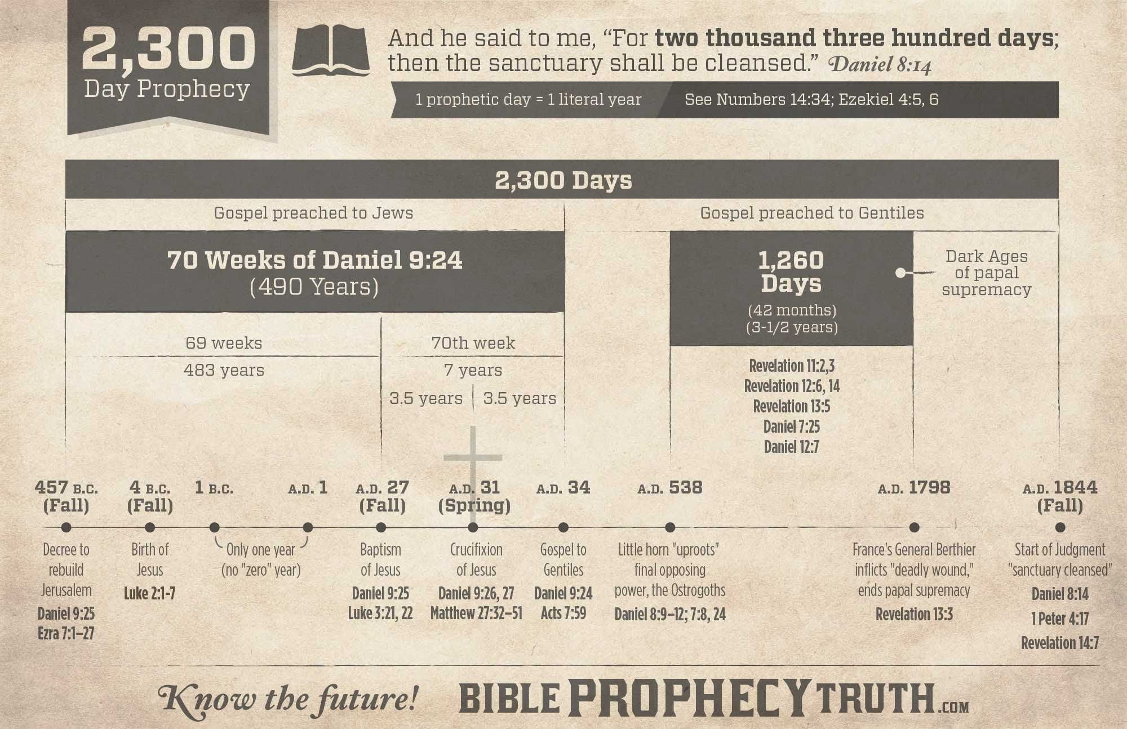
Once we find the decree to restore and to build Jerusalem in 457 BC, we can calculate 2300 “days” as 2300 literal (360-day) years, not counting the year 0, of course, which does not exist. And that’s how we can calculate the end of the 2300 day prophecy to (roughly) October 22, 1844.
How Did We Get to 1844 Anyway?

Slide 58
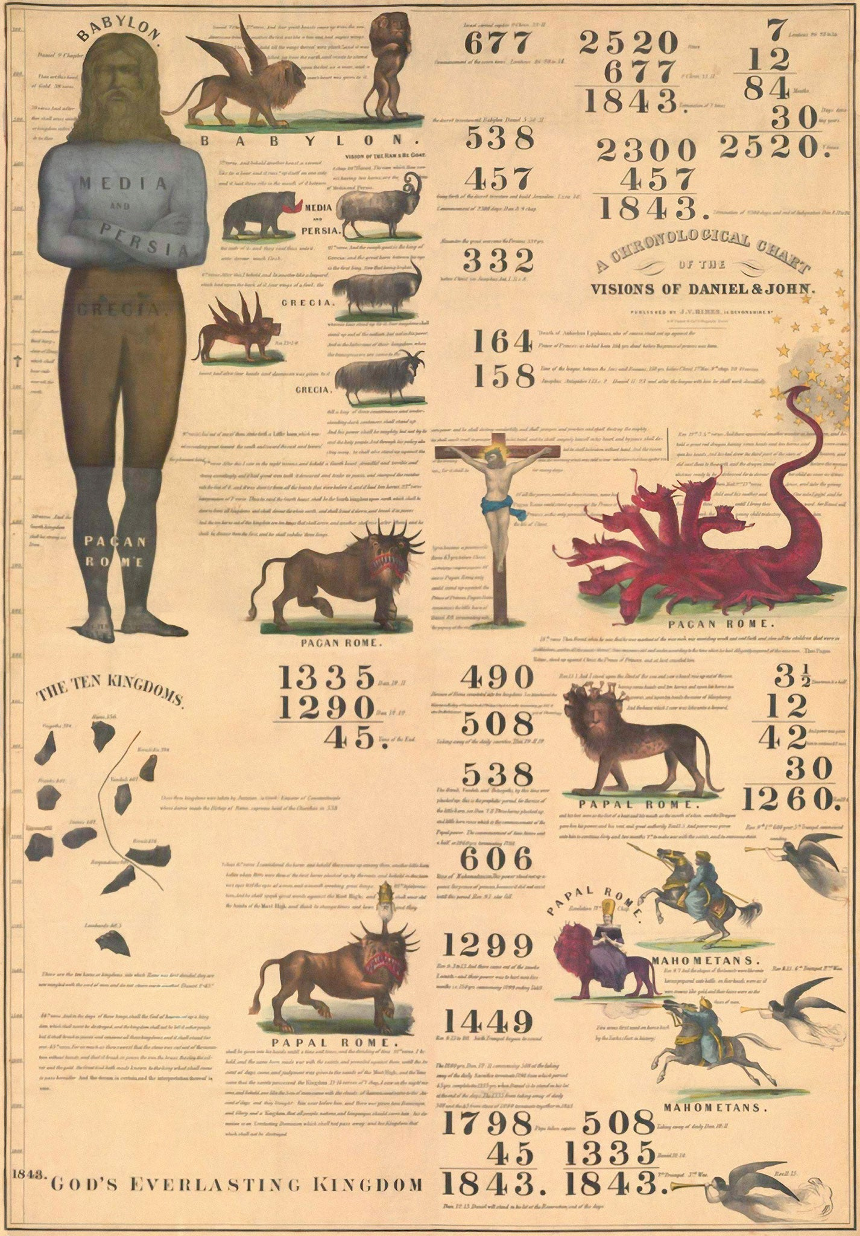
The Great Controversy, p. 351
“William Miller and his associates did not, themselves, fully comprehend the import of the message which they bore. Errors that had been long established in the church prevented them from arriving at a correct interpretation of an important point in the prophecy. Therefore, though they proclaimed the message which God had committed to them to be given to the world, yet through a misapprehension of its meaning they suffered disappointment.”

Slide 59
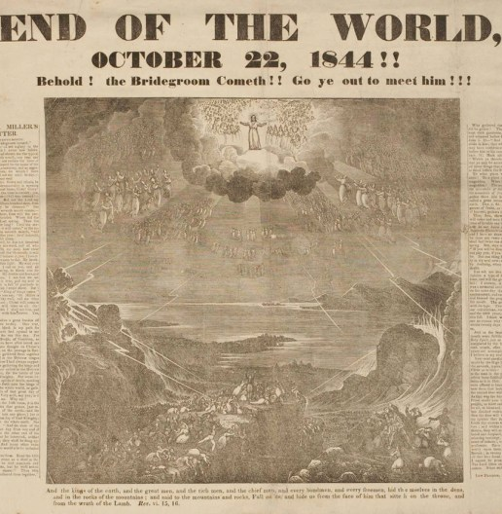
“In explaining Daniel 8:14, Miller, as has been stated, adopted the generally received view that the earth is the sanctuary, and he believed that the cleansing of the sanctuary represented the purification of the earth by fire at the coming of the Lord.”

Slide 60
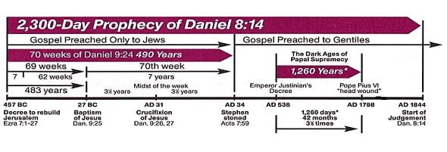
The Great Controversy, p. 352
“When, therefore, he found that the close of the 2300 days was definitely foretold, he concluded that this revealed the time of the second advent. His error resulted from accepting the popular view as to what constitutes the sanctuary.”

Slide 61
Of course, Jesus didn’t return in the fall of 1844! So what, exactly, did happen?
¹⁴ And he said unto me, Unto two thousand and three hundred days; then shall the sanctuary be cleansed.
-Daniel 8:14

Slide 62
The Day of Atonement
We know that Jesus is our Archetypal Sacrifice, that His blood is offered freely to cover sins. (²⁰ And, having made peace through the blood of his cross, by him to reconcile all things unto himself; by him, I say, whether they be things in earth, or things in heaven. -Col. 1:20). But curiously, the typical or symbolic sanctuary service was not completed with the sacrificial lamb. There was a second step to the symbolic, typical, purification of sins:
The Day of Atonement.

Slide 63
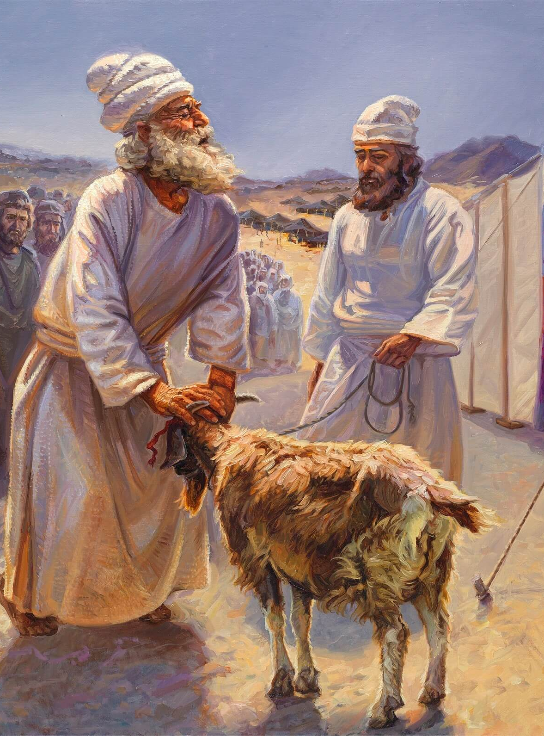
The Day of Atonement
The Day of Atonement (Yom Kippur) is the highest holy day of the Jewish calendar. In the Old Testament, the High Priest made an atoning sacrifice for the sins of the people on the Day of Atonement. This brought reconciliation (a restored relationship) between the people and God.

Slide 64
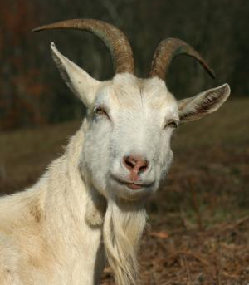
The Day of Atonement
After the sacrificial animal was offered to the Lord, a goat was released into the wilderness to symbolically carry away the sins of the people. This "scapegoat" was never to return.

Slide 65
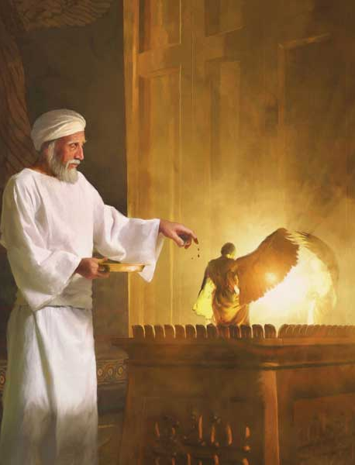
The Day of Atonement
The main description of the Day of Atonement is found in Leviticus 16:8-34. Additional regulations pertaining to the feast are outlined in Leviticus 23:26-32 and Numbers 29:7-11.
So if this is the typical Day of Atonement, what does it mean for us? What is the archetypal Day of Atonement?

Slide 66
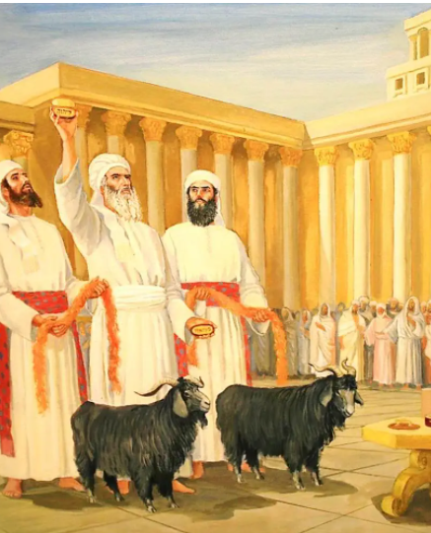
The Day of Atonement
We read in Levi­ticus 16 that after the high priest had accom­plished what was necessary for his own purification and also that of his house:
a. He was to take two kids of the goats for a sin offering (verse 5).
b. He was to cast lots, one for the Lord; the other for Azazel (verse 8, R.S.V.).

Slide 67

The Sanctuary Cleansed: Hebrews 8:1-2
8 Now of the things which we have spoken this is the sum: We have such an high priest, who is set on the right hand of the throne of the Majesty in the heavens;

Slide 68

The Sanctuary Cleansed: Hebrews 8:2
² A minister of the sanctuary, and of the true tabernacle, which the Lord pitched, and not man.

Slide 69

The Sanctuary Cleansed: Hebrews 9:11-12
¹¹ But Christ being come an high priest of good things to come, by a greater and more perfect tabernacle, not made with hands, that is to say, not of this building;

Slide 70

The Day of Atonement
c. The high priest was to "bring the goat upon which the Lord's lot fell, and offer him for a sin offering" (verse 9).

Slide 71

The Sanctuary Cleansed: Hebrews 9:12
¹² Neither by the blood of goats and calves, but by his own blood he entered in once into the holy place, having obtained eternal redemption for us.

Slide 72

The Day of Atonement
d. The High Priest then entered the Most Holy Place-a place entered only once a year, on the Day of Atonement-and sprinkled the blood of the sacrificed lamb on and before the mercy seat, on top of the Ark of the Covenant. Verse 16 says “And he shall make atonement for the holy place, because of the uncleanness of the children of Israel, and because of their transgressions in all their sins.”

Slide 73

The Sanctuary Cleansed: Hebrews 9:7
⁷ But into the second went the high priest alone once every year, not without blood, which he offered for himself, and for the errors of the people:

Slide 74

The Sanctuary Cleansed: Hebrews 9:23-26
²³ It was therefore necessary that the patterns of things in the heavens should be purified with these; but the heavenly things themselves with better sacrifices than these.

Slide 75

The Sanctuary Cleansed: Hebrews 9:24-26
²⁴ For Christ is not entered into the holy places made with hands, which are the figures of the true; but into heaven itself, now to appear in the presence of God for us:

Slide 76

The Sanctuary Cleansed: Hebrews 9:25-26
²⁵ Nor yet that he should offer himself often, as the high priest entereth into the holy place every year with blood of others;

Slide 77

The Sanctuary Cleansed: Hebrews 9:26
²⁶ For then must he often have suffered since the foundation of the world: but now once in the end of the world hath he appeared to put away sin by the sacrifice of himself.

Slide 78

The Day of Atonement
e. The high priest was also to take the goat on which the lot for Azazel fell, confess over him the sins of the people of Israel and send him to the wilderness (verses 21, 22).

Slide 79

The Day of Atonement
The “Azazel” goat, or scapegoat, represents an entity that is posed in direct opposition to the Lord.
The scapegoat is not a sin offering (Lev. 16:10). The goat for the "sin offering" represented Christ, who "died for our sins" (1 Cor. 15:3); the other represented Sa­tan, who will perish for his own sins, and also for his part in all the sins he caused the children of God to commit (Rev. 20: 10, 12).

Slide 80

The Great Controversy, p. 352
“In the typical system, which was a shadow of the sacrifice and priesthood of Christ, the cleansing of the sanctuary was the last service performed by the high priest in the yearly round of ministration. It was the closing work of the atonement—a removal or putting away of sin from Israel.”

Slide 81

The Great Controversy, p. 352
“It prefigured the closing work in the ministration of our High Priest in heaven, in the removal or blotting out of the sins of His people, which are registered in the heavenly records. This service involves a work of investigation, a work of judgment; and it immediately precedes the coming of Christ in the clouds of heaven with power and great glory; for when He comes, every case has been decided.”

Slide 82

The Great Controversy, p. 352
“Those who proclaimed this warning gave the right message at the right time. …As the disciples were mistaken in regard to the kingdom to be set up at the end of the seventy weeks, so Adventists were mistaken in regard to the event to take place at the expiration of the 2300 days.”

Slide 83

The Great Controversy, p. 352
“In both cases there was an acceptance of, or rather an adherence to, popular errors that blinded the mind to the truth. Both classes fulfilled the will of God in delivering the message which He desired to be given, and both, through their own misapprehension of their message, suffered disappointment.”

Slide 84

The Great Controversy, p. 353
“Yet God accomplished His own beneficent purpose in permitting the warning of the judgment to be given just as it was. The great day was at hand, and in His providence the people were brought to the test of a definite time, in order to reveal to them what was in their hearts.”

Slide 85
1: A separation of true believers from mere claimants must take place at the end.
The Investigative Judgment:
Matthew 13:47-50
⁴⁷ Again, the kingdom of heaven is like unto a net, that was cast into the sea, and gathered of every kind:
⁴⁸ Which, when it was full, they drew to shore, and sat down, and gathered the good into vessels, but cast the bad away.

Slide 86
1: A separation of true believers from mere claimants must take place at the end.
The Investigative Judgment:
Matthew 13:47-50
⁴⁹ So shall it be at the end of the world: the angels shall come forth, and sever the wicked from among the just,
⁵⁰ And shall cast them into the furnace of fire: there shall be wailing and gnashing of teeth.

Slide 87
1: A separation of true believers from mere claimants must take place at the end.
The Investigative Judgment:
Matthew 13:30, 40-43
³⁰ Let both grow together until the harvest: and in the time of harvest I will say to the reapers, Gather ye together first the tares, and bind them in bundles to burn them: but gather the wheat into my barn.
⁴⁰ As therefore the tares are gathered and burned in the fire; so shall it be in the end of this world.

Slide 88
1: A separation of true believers from mere claimants must take place at the end.
The Investigative Judgment:
Matthew 13:30, 40-43
⁴¹ The Son of man shall send forth his angels, and they shall gather out of his kingdom all things that offend, and them which do iniquity;
⁴² And shall cast them into a furnace of fire: there shall be wailing and gnashing of teeth.
⁴³ Then shall the righteous shine forth as the sun in the kingdom of their Father. Who hath ears to hear, let him hear.

Slide 89
2: God searches hearts THEN He rewards. He always investigates the facts first.
The Investigative Judgment:
Genesis 3:9-11
⁹ And the Lord God called unto Adam, and said unto him, Where art thou?
¹⁰ And he said, I heard thy voice in the garden, and I was afraid, because I was naked; and I hid myself.
¹¹ And he said, Who told thee that thou wast naked? Hast thou eaten of the tree, whereof I commanded thee that thou shouldest not eat?

Slide 90
2: God searches hearts THEN He rewards. He always investigates the facts first.
The Investigative Judgment:
Genesis 4:9
⁹ And the Lord said unto Cain, Where is Abel thy brother? And he said, I know not: Am I my brother's keeper?

Slide 91
2: God searches hearts THEN He rewards. He always investigates the facts first.
The Investigative Judgment:
Genesis 11:4-5
⁴ And they said, Go to, let us build us a city and a tower, whose top may reach unto heaven; and let us make us a name, lest we be scattered abroad upon the face of the whole earth.
⁵ And the Lord came down to see the city and the tower, which the children of men builded.

Slide 92
2: God searches hearts THEN He rewards. He always investigates the facts first.
The Investigative Judgment:
Genesis 18:20-21
²⁰ And the Lord said, Because the cry of Sodom and Gomorrah is great, and because their sin is very grievous;
²¹ I will go down now, and see whether they have done altogether according to the cry of it, which is come unto me; and if not, I will know.

Slide 93
2: God searches hearts THEN He rewards. He always investigates the facts first.
The Investigative Judgment:
Revelation 2:23
²³ And I will kill her children with death; and all the churches shall know that I am he which searcheth the reins and hearts: and I will give unto every one of you according to your works.

Slide 94
3: Just such an investigation is depicted just prior to the wedding feast.
The Investigative Judgment:
Matthew 22:10-14
¹⁰ So those servants went out into the highways, and gathered together all as many as they found, both bad and good: and the wedding was furnished with guests.
¹¹ And when the king came in to see the guests, he saw there a man which had not on a wedding garment:

Slide 95
3: Just such an investigation is depicted just prior to the wedding feast.
The Investigative Judgment:
Matthew 22:10-14
12 And he saith unto him, Friend, how camest thou in hither not having a wedding garment? And he was speechless.
13 Then said the king to the servants, Bind him hand and foot, and take him away, and cast him into outer darkness, there shall be weeping and gnashing of teeth.
14 For many are called, but few are chosen.

Slide 96
3: Just such an investigation is depicted just prior to the wedding feast.
The Investigative Judgment:
Luke 12:35-37
³⁵ Let your loins be girded about, and your lights burning;
³⁶ And ye yourselves like unto men that wait for their lord, when he will return from the wedding; that when he cometh and knocketh, they may open unto him immediately.
³⁷ Blessed are those servants, whom the lord when he cometh shall find watching: verily I say unto you, that he shall gird himself, and make them to sit down to meat, and will come forth and serve them.

Slide 97
3: Just such an investigation is depicted just prior to the wedding feast.
The Investigative Judgment:
Matthew 25:3-4
³ They that were foolish took their lamps, and took no oil with them:
⁴ But the wise took oil in their vessels with their lamps.

Slide 98
4: The Judgment must occur before Christ receives His kingdom, which happens just prior to His triumphant return.
The Investigative Judgment:
Daniel 7:9, 10, 13, 14
⁹ I beheld till the thrones were cast down, and the Ancient of days did sit, whose garment was white as snow, and the hair of his head like the pure wool: his throne was like the fiery flame, and his wheels as burning fire.
¹⁰ A fiery stream issued and came forth from before him: thousand thousands ministered unto him, and ten thousand times ten thousand stood before him: the judgment was set, and the books were opened.

Slide 99
4: The Judgment must occur before Christ receives His kingdom, which happens just prior to His triumphant return.
The Investigative Judgment:
Daniel 7:9, 10, 13, 14
¹³ I saw in the night visions, and, behold, one like the Son of man came with the clouds of heaven, and came to the Ancient of days, and they brought him near before him.
¹⁴ And there was given him dominion, and glory, and a kingdom, that all people, nations, and languages, should serve him: his dominion is an everlasting dominion, which shall not pass away, and his kingdom that which shall not be destroyed.

Slide 100
5: The verb tense (aorist) describing the judgement suggests it has already started.
The Investigative Judgment:
Revelation 14:6, 7, 9
⁶ And I saw another angel fly in the midst of heaven, having the everlasting gospel to preach unto them that dwell on the earth, and to every nation, and kindred, and tongue, and people,
⁷ Saying with a loud voice, Fear God, and give glory to him; for the hour of his judgment is come: and worship him that made heaven, and earth, and the sea, and the fountains of waters.

Slide 101
6: The books record our choices, and an investigation of these choices must occur before judgment can be rendered.
The Investigative Judgment:
John 3:36
³⁶ He that believeth on the Son hath everlasting life: and he that believeth not the Son shall not see life; but the wrath of God abideth on him.

Slide 102
6: The books record our choices, and an investigation of these choices must occur before judgment can be rendered.
The Investigative Judgment:
1 John 5:11-12
¹¹ And this is the record, that God hath given to us eternal life, and this life is in his Son.
¹² He that hath the Son hath life; and he that hath not the Son of God hath not life.

Slide 103
6: The books record our choices, and an investigation of these choices must occur before judgment can be rendered.
The Investigative Judgment:
Exodus 32:32-33
³² Yet now, if thou wilt forgive their sin--; and if not, blot me, I pray thee, out of thy book which thou hast written.
³³ And the Lord said unto Moses, Whosoever hath sinned against me, him will I blot out of my book.

Slide 104
6: The books record our choices, and an investigation of these choices must occur before judgment can be rendered.
The Investigative Judgment:
Psalm 69:28
²⁸ Let them be blotted out of the book of the living, and not be written with the righteous.

Slide 105
6: The books record our choices, and an investigation of these choices must occur before judgment can be rendered.
The Investigative Judgment:
Revelation 3:5
⁵ He that overcometh, the same shall be clothed in white raiment; and I will not blot out his name out of the book of life, but I will confess his name before my Father, and before his angels.

Slide 106
6: The books record our choices, and an investigation of these choices must occur before judgment can be rendered.
The Investigative Judgment:
Revelation 22:19
¹⁹ And if any man shall take away from the words of the book of this prophecy, God shall take away his part out of the book of life, and out of the holy city, and from the things which are written in this book.

Slide 107
7: The DEAD are judged out of the books
The Investigative Judgment:
Revelation 20:12-13
¹² And I saw the dead, small and great, stand before God; and the books were opened: and another book was opened, which is the book of life: and the dead were judged out of those things which were written in the books, according to their works.
¹³ And the sea gave up the dead which were in it; and death and hell delivered up the dead which were in them: and they were judged every man according to their works.

Slide 108

Thank You!
Happy Sabbath!!

